Slide 1



Slide 2


Looking to be
Incredibly ‘Accurate’ ?

Slide 3


Do you spend a
fortune on printing?
Are you looking to save?
You can now save upto 50%*
of your printing costs
with Accurate !
MEDICAL IMAGING PRINT SOLUTION

Slide 4
What do we
provide you
with?
DICOM SOFTWARE
NO CAPITAL EXPENSE
PEACE OF MIND
MAINTENANCE
Everything you’ll need – we’re
Your end-to-end solutions
provider!
PRINTER
MEDICAL IMAGING PRINT SOLUTION

Slide 5




CONNECT TO
MULTIPLE
MODALITIES
CUSTOMISABLE
SOFTWARE
Why
Accurate?
VERSATILE
PRINT
SOLUTIONS
(ON BLUE BASE FILM,
WHITE MEDICAL GRADE FILM, PAPER)
HASSLE-FREE
SERVICE
MEDICAL IMAGING PRINT SOLUTION

Slide 6
CLINICAL
EXCELLENCE
WE PRINT WHAT
YOU PROCESS
FROM ALL
MODALITIES
What do
you stand
to gain?
OPERATIONAL
EFFICIENCY
USER FRIENDLY,
QUICK PROCESSING
SOFTWARE
A lot, actually
INCREASED
PROFITABILITY
ELIMINATE YOUR
ONGOING COSTS
WITH OUR
EFFECTIVE MODEL
MEDICAL IMAGING PRINT SOLUTION

Slide 7
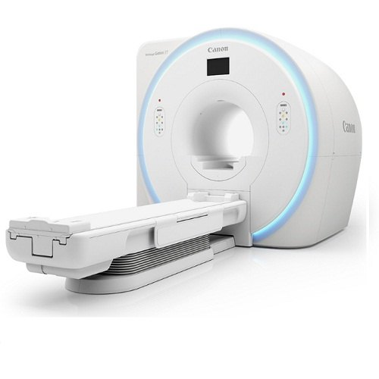
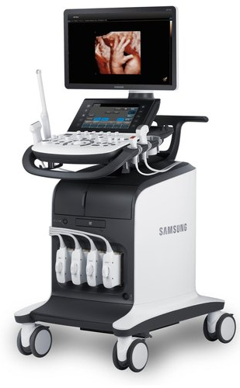
DICOM solutions by Accurate
DICOM Storage /
DICOM SCP
Connect to multiple
modalities with DICOM
MRI
CT
PET-CT
ULTRA
SOUND
X-RAY
OPG
MEDICAL IMAGING PRINT SOLUTION

Slide 8

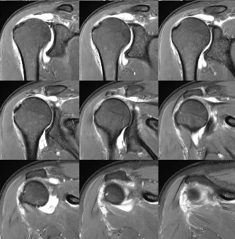
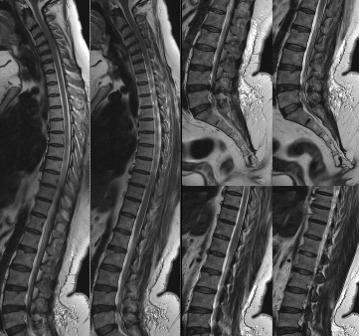
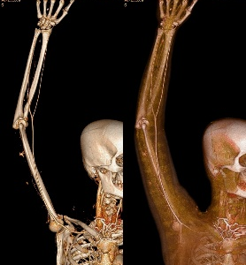
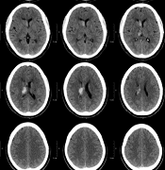
MRI
CT
MEDICAL IMAGING PRINT SOLUTION

Slide 9
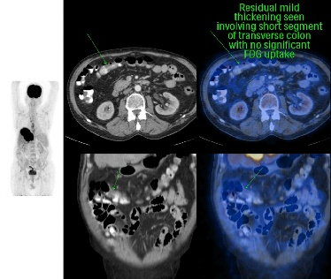
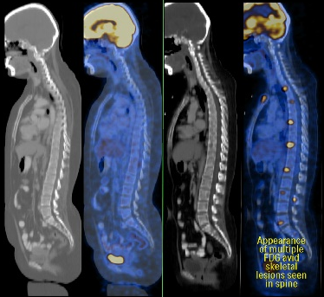
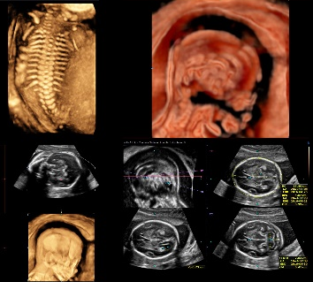
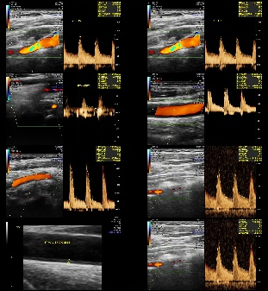
PET-CT
ULTRA
SOUND
MEDICAL IMAGING PRINT SOLUTION

Slide 10
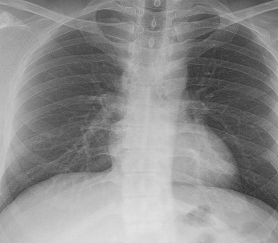
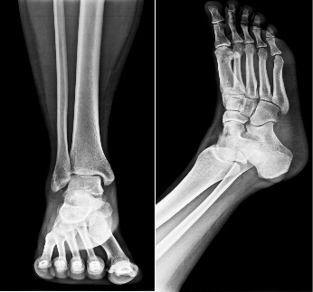
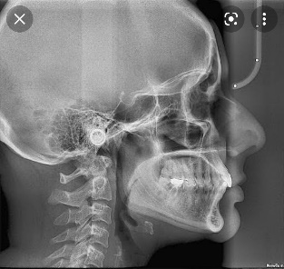
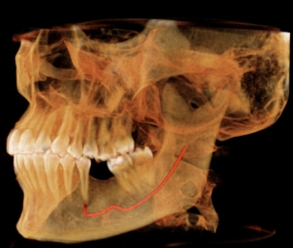
X-RAY
OPG
MEDICAL IMAGING PRINT SOLUTION

Slide 11


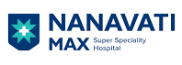


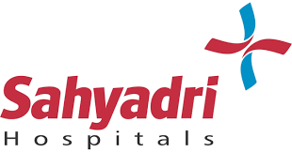





MEDICAL IMAGING PRINT SOLUTION

Slide 12














MEDICAL IMAGING PRINT SOLUTION

Slide 13



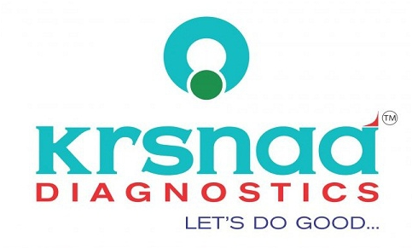



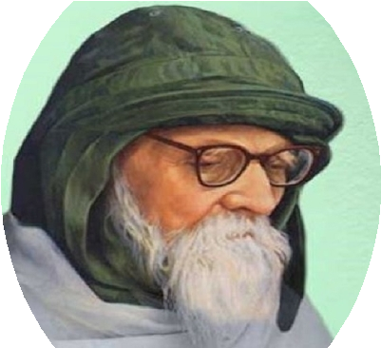






MEDICAL IMAGING PRINT SOLUTION

Slide 14

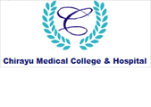







MEDICAL IMAGING PRINT SOLUTION

Slide 15
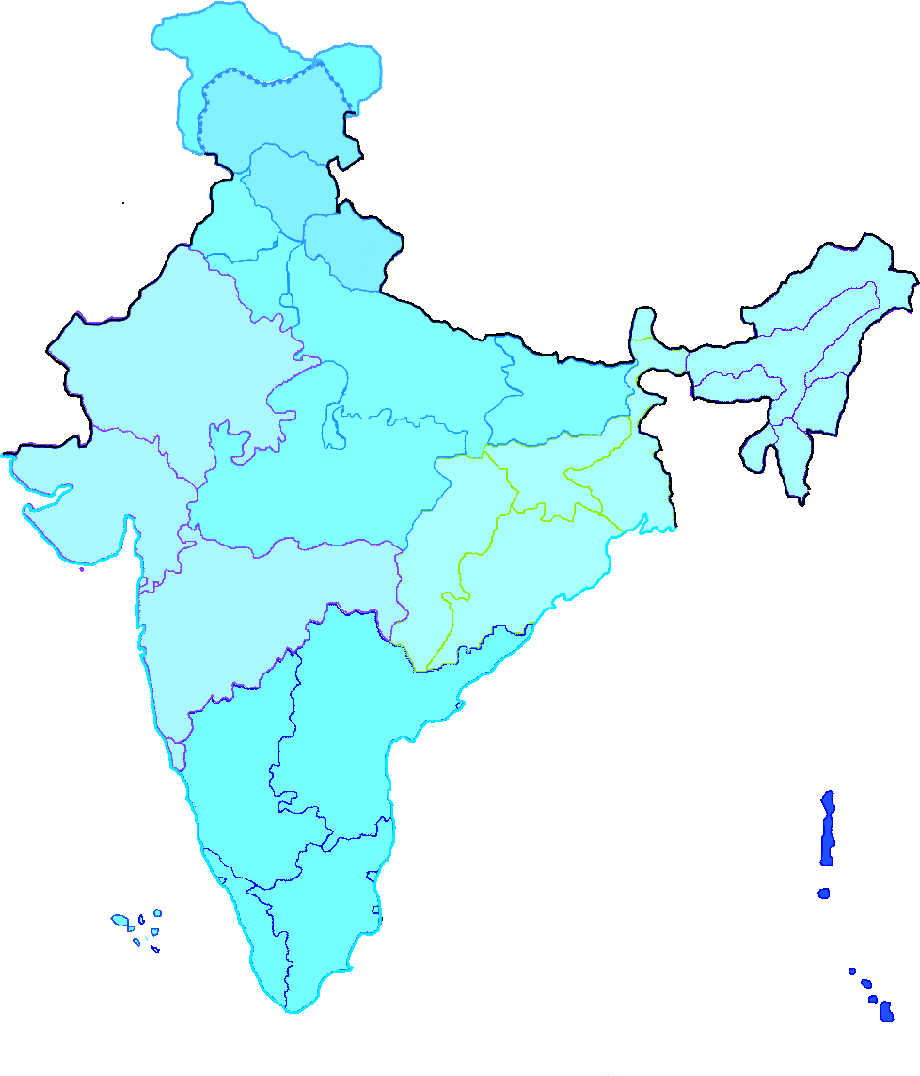


Customer Base
Himachal
Pradesh
Punjab
Uttarakhand
Haryana
Delhi/NCR
Rajasthan
Uttar Pradesh
Bihar
Gujarat
Madhya Pradesh
Jharkhand
West Bengal
Chhattisgarh
Odisha
Maharashtra
Telangana
Goa
Andhra Pradesh
Karnataka
Tamil Nadu
Kerala

Slide 16

Accurate Offices
Delhi
Bhopal
Kolkata
Nagpur
Mumbai
Pune
Bengaluru

Slide 17

MEDICAL IMAGING PRINT SOLUTION

Slide 18


Contact Us
+91 9157976333
vandaninnovations@gmail.com

